Slide 1
Secure Web APP
Using Time-Varying QR Code MFA
Tanner Bacon
Solutions Architect Intern 2022
Notes:
Introduction:
I am … and today I want to show you …
Who are you?
What do you want out of this meeting?
What aspects are you most interested in? (Security, finances, scalability?)

Slide 2
Agenda
Problem Statement
Technical Challenges
Proposed Solution
Demo
Pricing and ROI
Recap
Notes:
Set expectations
How this works
How it can scale
What this framework provides
The things they’re most interested in

Slide 3
Problem Statement
Notes:
What we are trying to accomplish with this framework.
What hurdles we want this framework to overcome.

Slide 4
Problem Statement
Users are often exposed to phishing activities and PII data leakage through traditional MFA authentication because it often requires exposes credentials (for example, email, username, and potentially reused passwords) in uncontrolled environments.
The purpose of this MVP is do demonstrate a mobile framework and a Serverless back-end on AWS that will allow customers to use QR codes for authenticated access to web applications.
Notes:
Static data
Reused passwords
PII data leakage
So we want to:
Eliminate static credentials
Sign the login request on an app-stored private key
Typing in static data such as emails or passwords on untrusted devices can lead to Personal Identifiable Information leakage.
Users often use the same password for many different accounts, which can leave them vulnerable when information is leaked.
Multi-Factor Authentication helps to verify users, but does not protect against the users’ login information from being stolen.
A session ID send in the form of a QR code will give the mobile app the information it needs to make a secure, direct connection to the backend. This will eliminate the need for untrusted hardware to interact with the users’ data.
get information about a request on a mobile app sent from a website through a QR code. The mobile app can then validate a secure request directly to the backend without requiring the use of static data anywhere on the website.
The implementation of 2FA mechanisms for access control in general involve the user entering static credentials in a web browser and subsequently entering an additional timed on-time password (TOTP) that is received via e-mail or SMS.
However, if the user has access to a mobile app where they have previously enrolled to that system, they can use an app-stored private key to authenticate to the web site without needing to enter any static credential, so avoiding the risk of PII data leakage (for example, email, username, and potentially reused passwords).

Slide 5
Technical Challenges
Notes:
Why this framework hasn’t been created before.
How AWS is the key to being able to accomplish such a framework.

Slide 6
Technical Challenges
Time and money
Synchronization of the programs
Requires AWS services
Notes:
KMS and Secrets Manager makes it much easier to sign and share data between apps.
AppSync simplifies app development to create a flexible API to combine data from multiple sources.
Cloud resources make it extremely cheap to implement these services in a secure way.

Slide 7
Proposed Solution
Notes:
This is a framework.
This can be used in many different ways and it can be expanded.
We used this to sign a session ID, but really it could sign any API call. This could be a secure payment, registration for an event, etc.

Slide 8
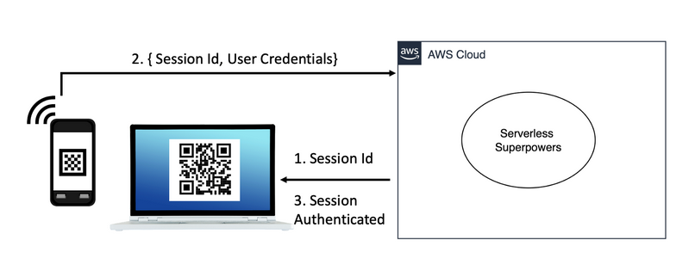
Proposed Solution
Website: QR code containing a Session ID
Mobile app: Scans QR code, sends API call to log in
Website: Session is authenticated, user is logged in
Notes:
The user is authenticated, their keys are created, and data is stored in DynamoDB.
The website is loaded, a sessionID is created (time varying) and encrypted. The webpage will then ping DynamoDB every 3 seconds to see if the user is logged in.
The encrypted string is displayed as a qr code. The mobile app scans the qr, decrypts it, and signs the sessionID with the user’s authenticated ID and the Mobile apps security keys.
The mobile app sends the signed data to the backend, where the users information is updated with a current sessionID and the users data in DynamoDB is updated as signed in.
The webpage displays the landing page or whatever else is assigned as the logged in page. This data can all be monitored through Cloudwatch. (Not included in demo)

Slide 9
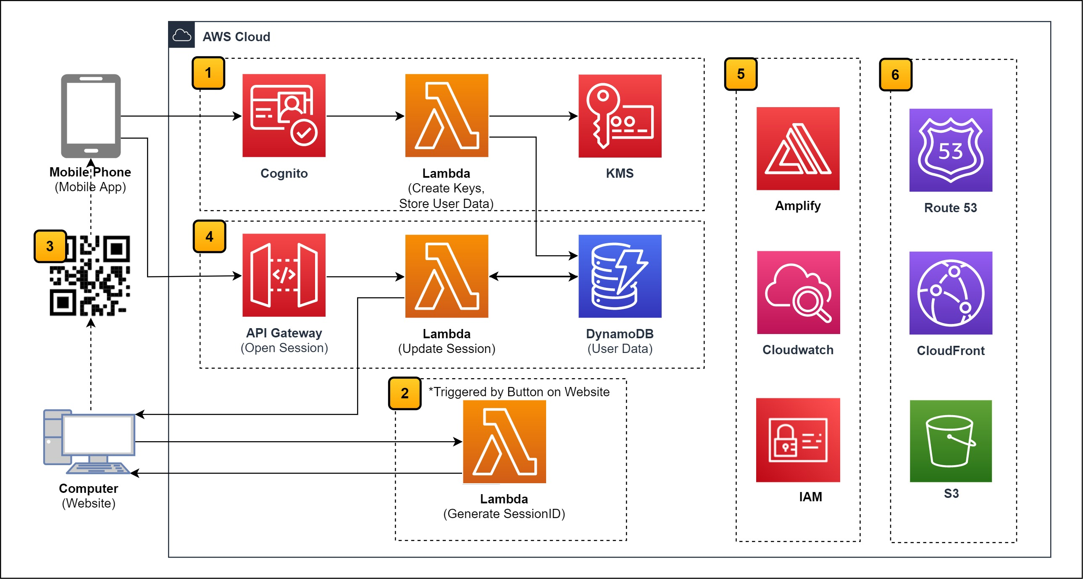
Proposed Architecture
Notes:
The user is authenticated, their keys are created, and data is stored in DynamoDB.
The website is loaded, a sessionID is created (time varying) and encrypted. The webpage will then ping DynamoDB every 3 seconds to see if the user is logged in.
The encrypted string is displayed as a qr code. The mobile app scans the qr, decrypts it, and signs the sessionID with the user’s authenticated ID and the Mobile apps security keys.
The mobile app sends the signed data to the backend, where the users information is updated with a current sessionID and the users data in DynamoDB is updated as signed in.
The webpage displays the landing page or whatever else is assigned as the logged in page. This data can all be monitored through Cloudwatch. (Not included in demo)

Slide 10
Demo
Notes:
The nature of the app makes it difficult to demo so I have made a video covering the functionality.
This is a Minimum Viable Product – only the essential functionality has been developed. This will give you an idea of the core benefits the product will provide to users.

Slide 11

Demo

Slide 12
Pricing and ROI

Slide 13
Pricing
Service | Upfront | Monthly | First 12 months total
Amazon Cognito | $ - | $ 275.00 | $ 3,300.00
AWS Lambda | $ - | $ 11.58 | $ 138.96
Amazon API Gateway | $ - | $ 10.50 | $ 126.00
DynamoDB reserved capacity | $ 180.00 | $ 32.70 | $ 572.40
AWS Key Management Service | $ - | $ 9.00 | $ 108.00
Total (100,000 Monthly Users) | $ 180.00 | $ 338.00 | $ 4,245.36
Notes:
Many services have potential free-tier benefits!
Pricing: NOT COSTLY -> WE CAN MITIGATE COST BY FINE TUNING TIME AND MEMORY. THERE IS ALSO THE POSIBILITY OF A FREE TIER AVAILABLE FOR SEVERAL SERVICES
Cognito: Advanced security features (Disabled), Number of monthly active users (MAU) (50000)
AWS Lambda: Architecture (Arm), Architecture (x86), Time for which Provisioned Concurrency is enabled (5 hours), Amount of ephemeral storage allocated (512 MB), Number of requests (5 million per month)
AWS Key Management System: Number of customer managed Customer Master Keys (CMK) (0), Number of symmetric requests (0), Number of asymmetric requests except RSA 2048 (0), Number of ECC GenerateDataKeyPair requests (0), Number of RSA GenerateDataKeyPair requests (0)
API Gateway: Number of API Requests (150 thousand per month)
DynamoDB: Table class (Standard), Average item size (all attributes) (1 KB), Data storage size (0.05 GB)
Secrets Manager: Number of secrets (5), Average duration of each secret (30 days), Number of API calls (150000 per month) – automates rotation
More than 5 gb cloudwatch will add 0.50 per log and for storage

Slide 14
Recap

Slide 15
Recap
Problem Statement
Technical Challenges
Proposed Solution
Demo
Pricing and ROI
Notes:
What problem we are trying to solve.
Why is hasn’t been solved before.
How we have tried to solve it now.
Then we took a look at the main benefits of the application in action
We dove into what this would cost

Slide 16
Tanner Bacon
FAQ and Appendix Included

Slide 17
Stretch Goals: Implementations
Signing into apps on public devices
Desktop applications
Payment at kiosks
Password manager
Notes:
Public device (avoid static data on untrusted devices)
Desktop app (security for a stolen device – information can’t be accessed)
Payments (The backend receives payment from the mobile device, kiosk never has access to payment info – avoid card skimming)
Password manager (data stored locally on mobile device, can use biometrics for additional security)

Slide 18
Alternative Solutions
Amplify framework alternatives
Encrypted key storage
Web application hosting
Authentication methods in API Gateway
SNS for Email or SMS verification
Containerized solutions replacing Lambda
Notes:
Amplify – AppSync and Cognito API calls
Key storage – Encrypted and stored in DynamoDB
Web hosting – Independently hosted and connected to DynamoDB OR DNS with Route 53, distributed and cached through CloudFront, stored in S3.
Authentication – IAM, API key, Unauthenticated

Slide 19
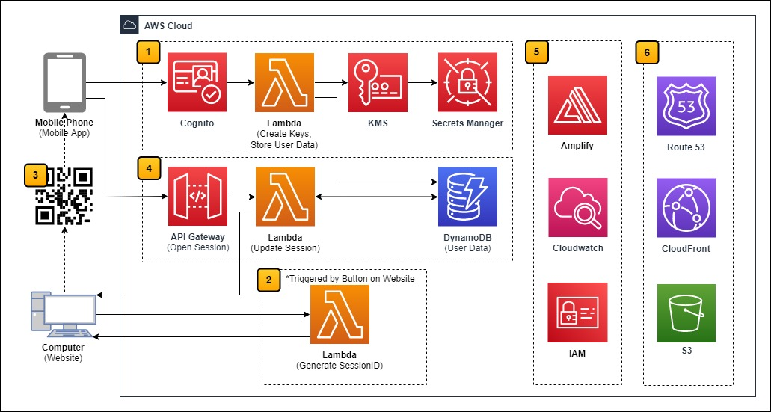
Proposed Architecture
Notes:
The user is authenticated, their keys are created, and data is stored in DynamoDB.
The website is loaded, a sessionID is created (time varying) and encrypted. The webpage will then ping DynamoDB every 3 seconds to see if the user is logged in.
The encrypted string is displayed as a qr code. The mobile app scans the qr, decrypts it, and signs the sessionID with the user’s authenticated ID and the Mobile apps security keys.
The mobile app sends the signed data to the backend, where the users information is updated with a current sessionID and the users data in DynamoDB is updated as signed in.
The webpage displays the landing page or whatever else is assigned as the logged in page. This data can all be monitored through Cloudwatch. (Not included in demo)

Slide 20
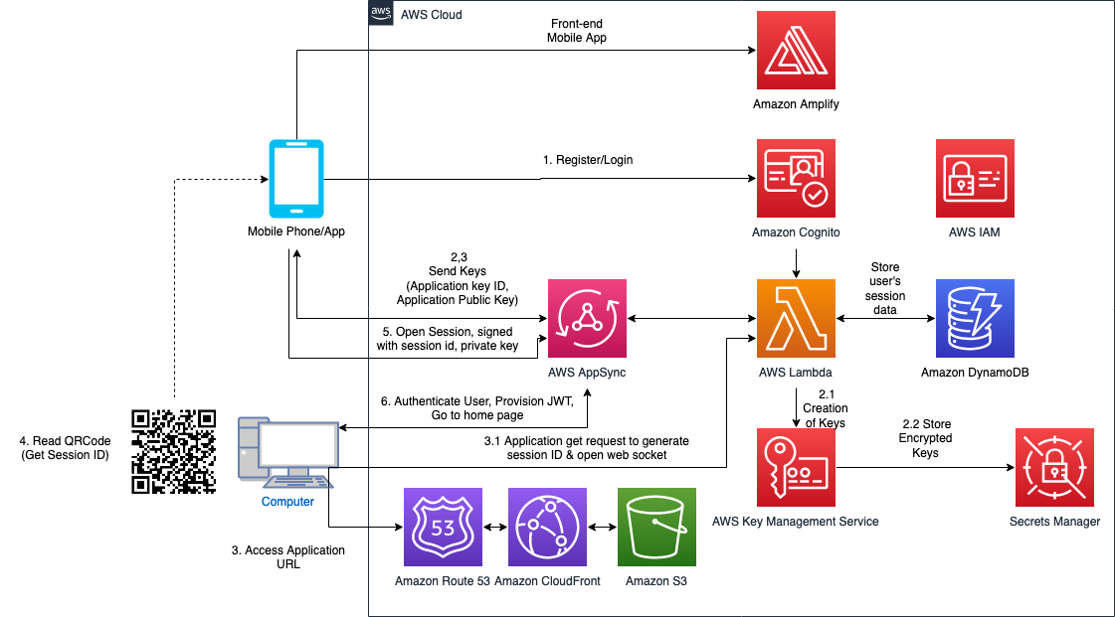
Proposed Architecture
Notes:
get information about a request on a mobile app sent from a website through a QR code. The mobile app can then validate a secure request directly to the backend without requiring the use of static data anywhere on the website.

Slide 21
User logs in into the mobile app, via Cognito, system receives public key and assigns it an ID (probably should be done during registration, and given an expiring time frame so user has to generate a new key, say every 90 days)
System sends user system key ID & system public key (SystemPublicKey)
User accesses website URL
User clicks on login.
System gets a login request from the website and opens a websocket between the browser and the System
Systems generates session data (SessionID) and associates it with the websocket connection
System bakes session data it into a QRCode. ---> Can we get rid of SALT? Yes
Systems sends the QR Code back to the website through the websocket.
Website presents a QR code
Mobile app scans QR code and interprets it to get the message.
Mobile app validates the session data
Mobile app sends a login-request via API Call (not through the websocket!)
System
System sends tokens back to the website via the websocket
website uses the tokens to initiate the session
user interacts with the website to validate that everything is working
Notes:
Static data
Reused passwords
PPI data leakage
So we want to:
Eliminate static credentials
Sign the login request on an app-stored private key

Slide 22
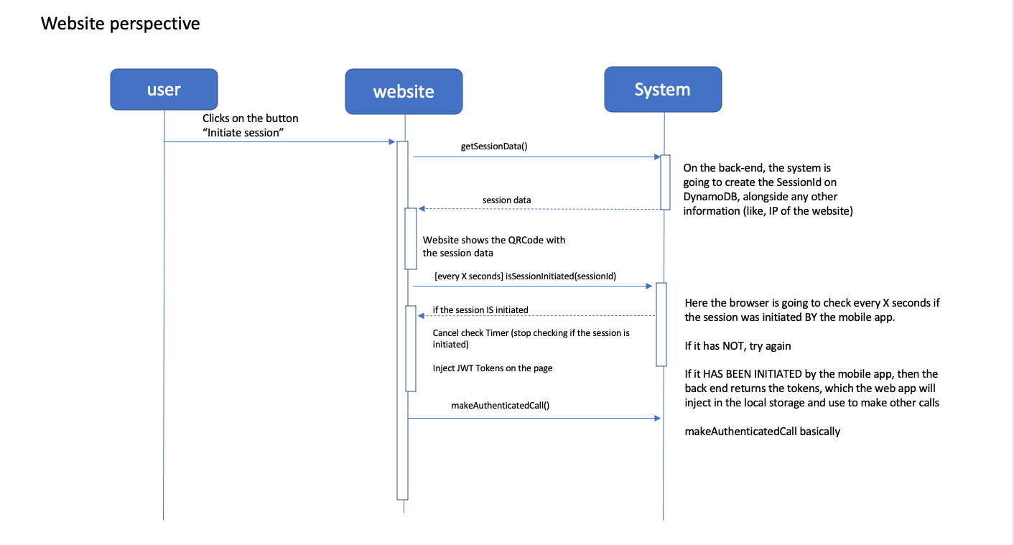

Slide 23
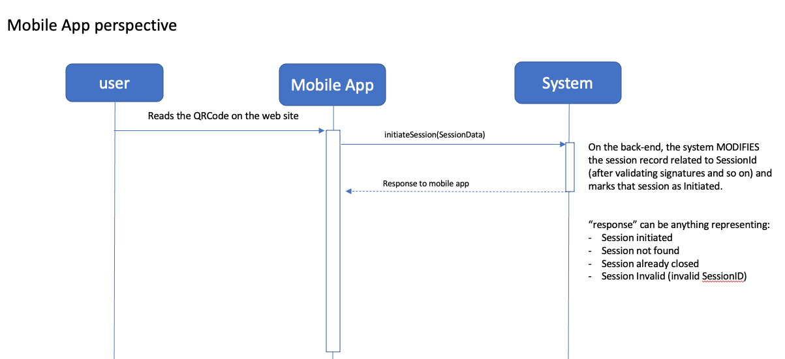

Slide 24
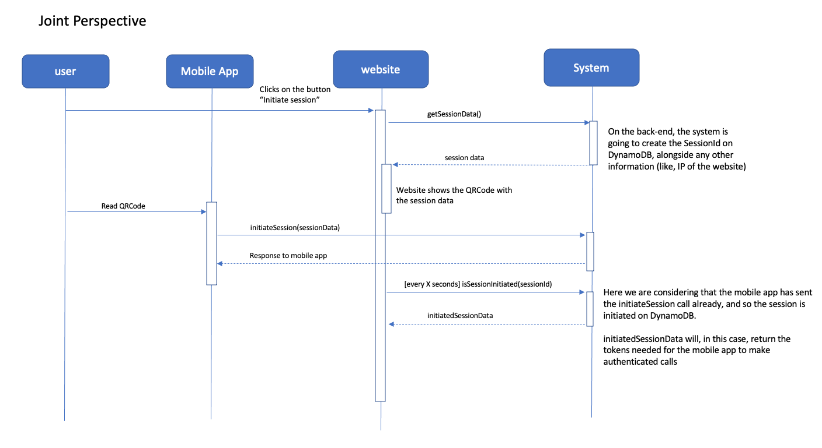

Slide 25
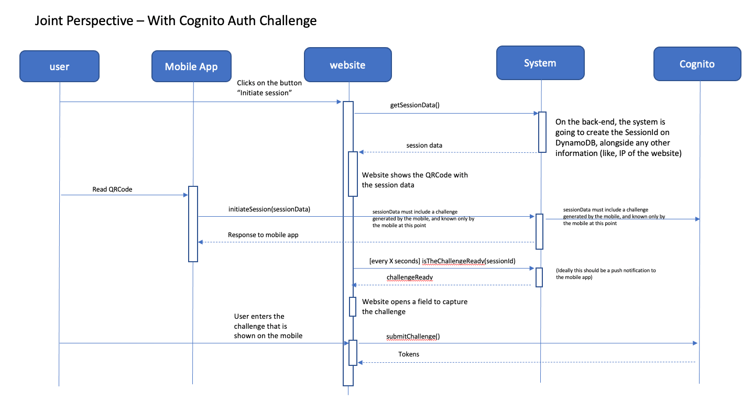

Slide 26
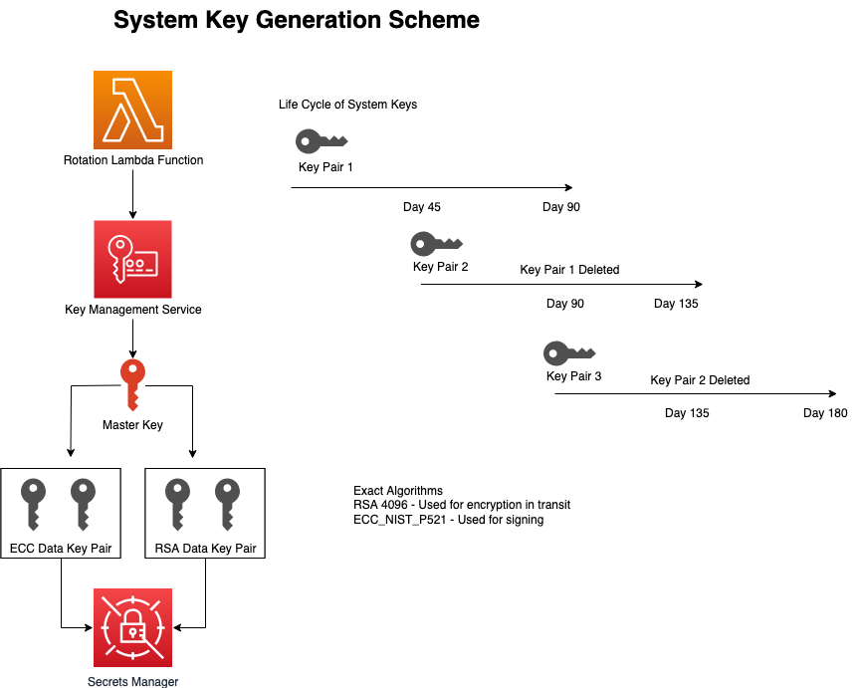

Slide 27
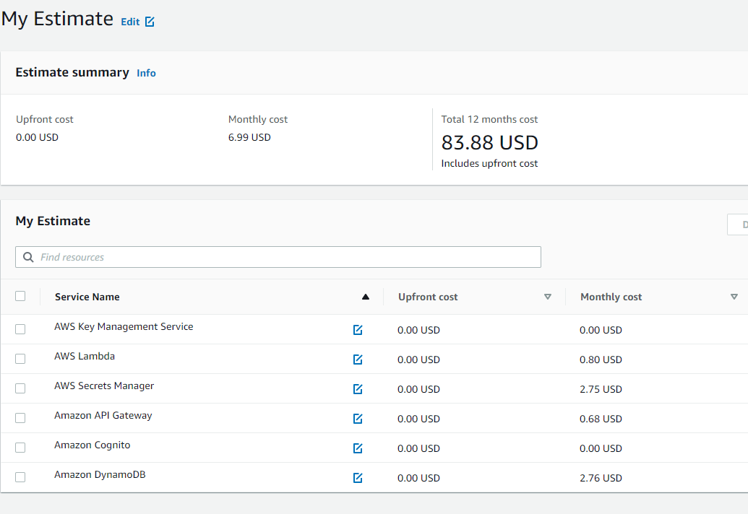
Pricing Calculator

